Slide 1


What is findOne? How to use it ?
What is pretty() ?
What is save()?
Difference between save() and update() ?

Slide 2
MongoDB CRUD Operations

Slide 3
Create the database with the name “address”

Slide 4
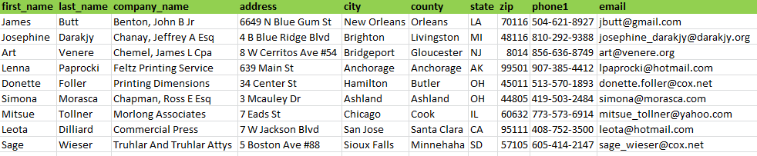
Insert the below data in one collection with the name “details”

Slide 5


Slide 6
Give me the information
Who are all living in the state “LA”.

Slide 7
Give me the information
Give me all the companies present in country “cook”.

Slide 8
Give me the information
Give me all data information than country information

Slide 9
Give me the information
Give me information other than first five companies

Slide 10
Give me the information
Give me information of first five companies in ascending order

Slide 11
Give me the information
Give me information other than first five companies in descending order

Slide 12
Change the data
change country as “Orleans” where has zip code is “8014”

Slide 13
Change the data
change all zip code as “00001” where state is “OH”

Slide 14
Remove the data
remove the data where state as “LA”

Slide 15

Find unique name in collection
Count the data in collection
Search for zipcode = 1111
    found update with zipcode =2222
    not found insert name=‘aa’ and zip code=‘0999’.

